Slide 1
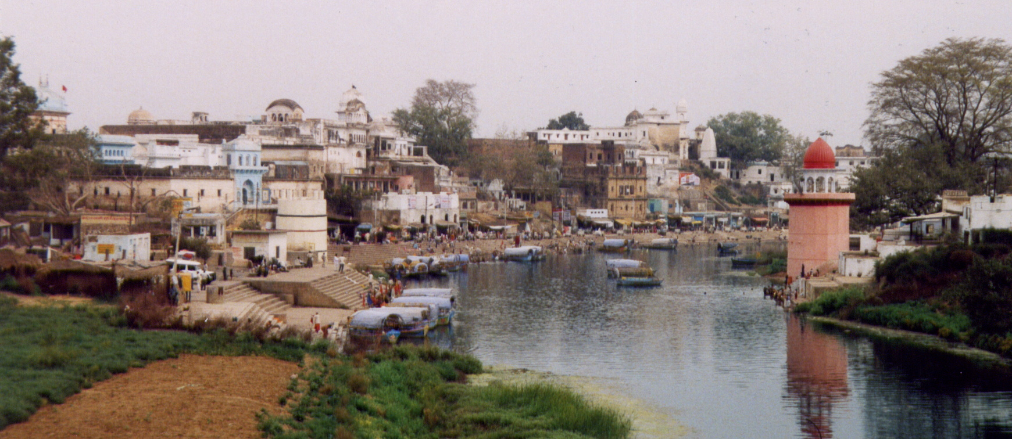
Climate Exercise – Day 2
KATHARINE HAYHOE

Slide 2
YESTERDAY …
STEP ONE: Opened the statistical programming package R on your computer. Follow the instructions so the program knows where to find the directories it will need.
STEPS TWO and THREE: Calculated climate indicators using two types of data: (1) weather station data for one of 64 different stations around India, and (2) gridded data covering all of India.

Slide 3
TODAY …
STEPS FOUR and FIVE: Plot the weather station projections using Excel, and plot the gridded data using a program called Panoply.

Slide 4
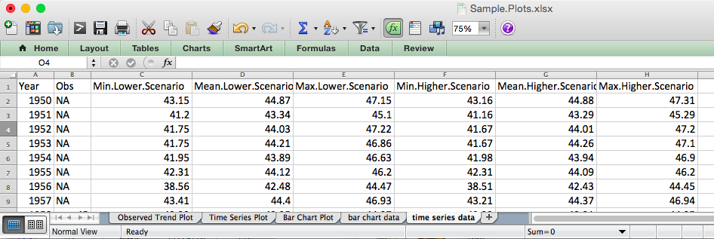
SAMPLE.PLOTS -> 3 TYPES OF EXCEL PLOTS

Slide 5
SAMPLE.PLOTS -> 3 TYPES OF EXCEL PLOTS

Slide 6
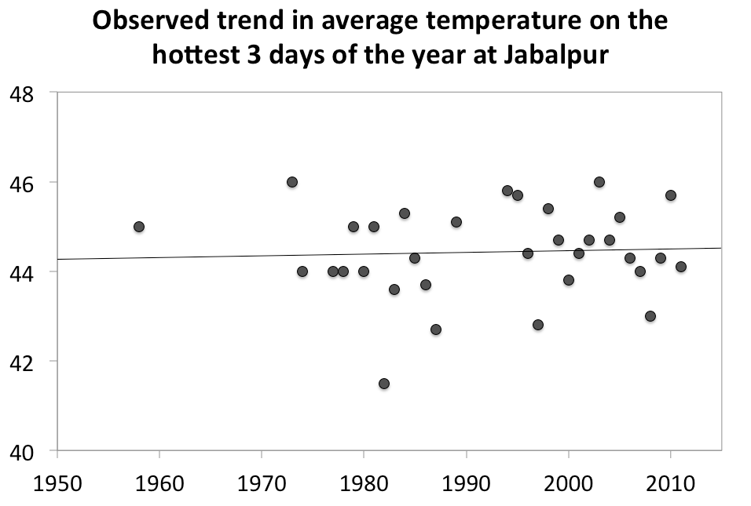
SAMPLE.PLOTS -> 3 TYPES OF EXCEL PLOTS

Slide 7
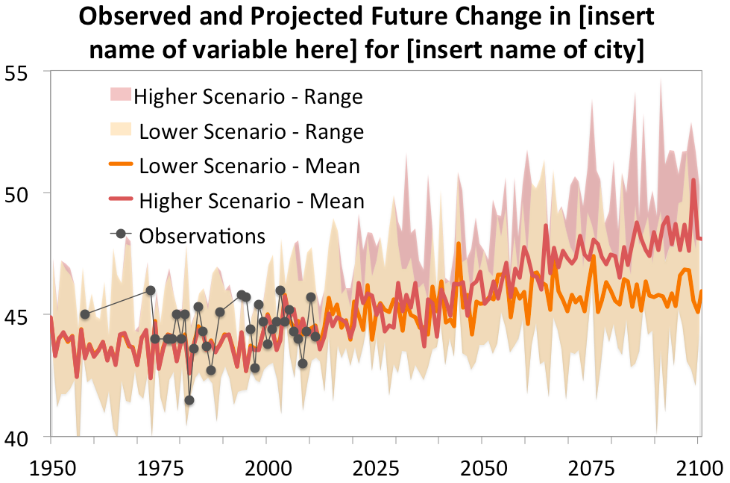
SAMPLE.PLOTS -> 3 TYPES OF EXCEL PLOTS

Slide 8
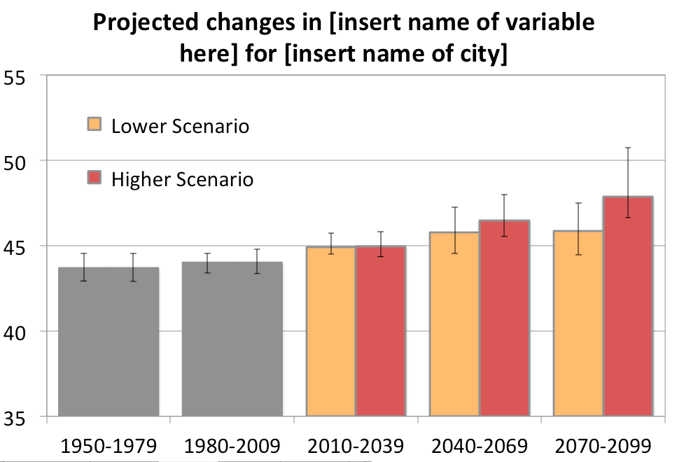
SAMPLE.PLOTS -> 3 TYPES OF EXCEL PLOTS

Slide 9
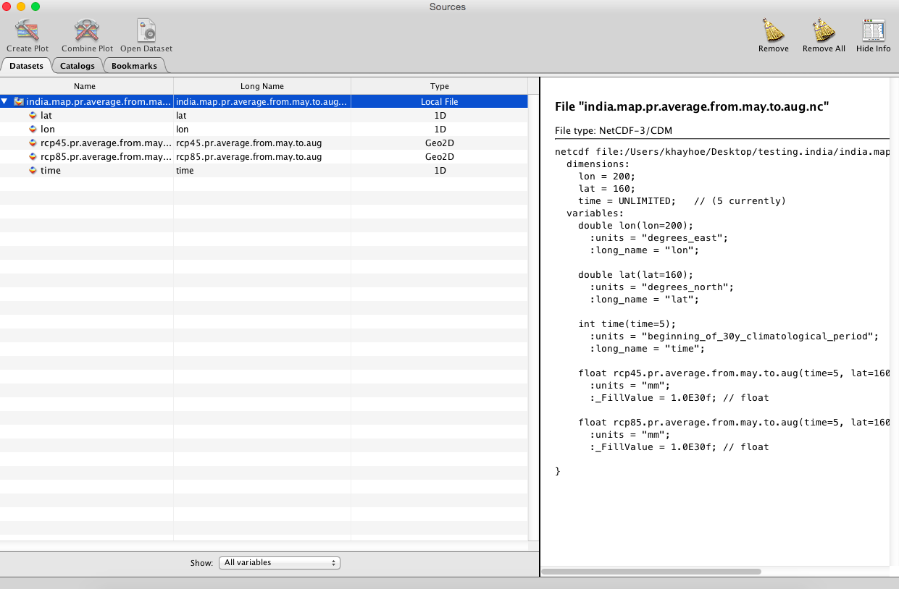
PANOPLY -> MAPS

Slide 10
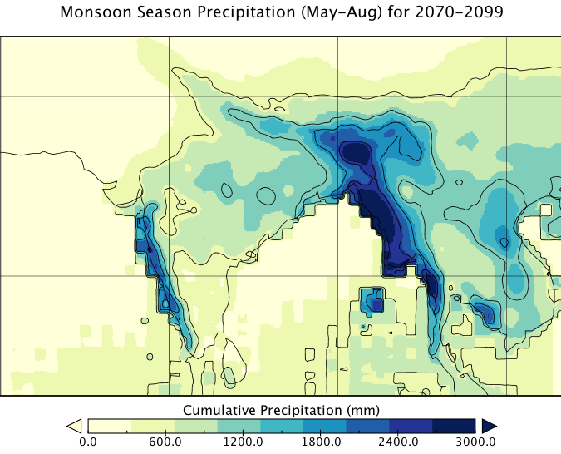
PANOPLY -> MAPS

Slide 11
TODAY …
STEPS FOUR and FIVE: Plot the weather station projections using Excel, and plot the gridded data using a program called Panoply.
STEP SEVEN: Calculate one or two more variables that are relevant to your city or region.

Slide 12
We care about
a changing climate
BECAUSE IT EXACERBATES MANY OF THE RISKS WE ALREADY FACE TODAY

Slide 13
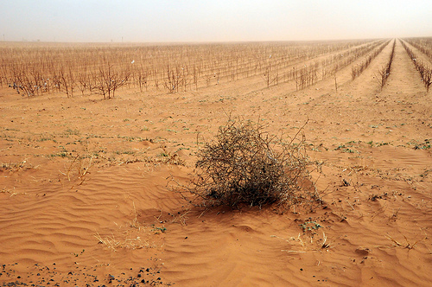
We’re vulnerable to drought

Slide 14
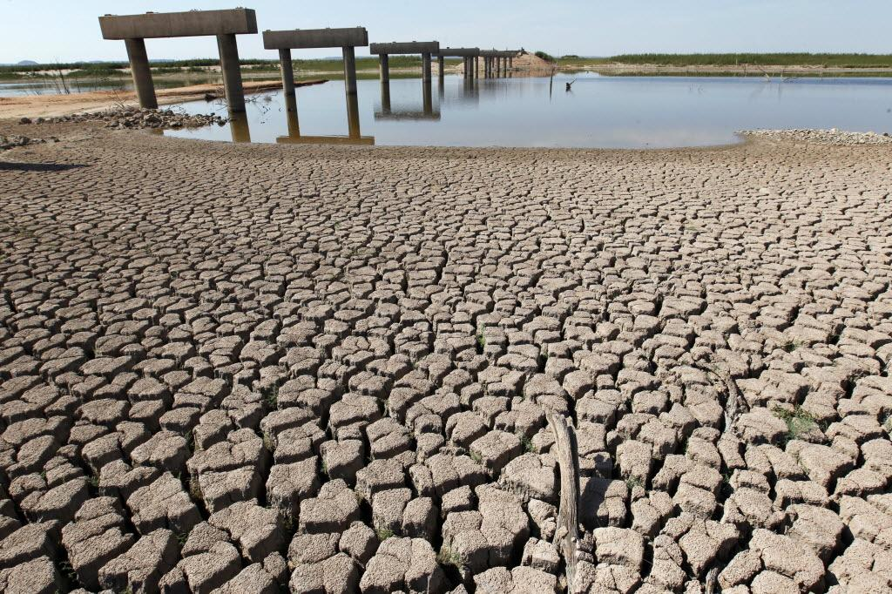
… and water shortages

Slide 15
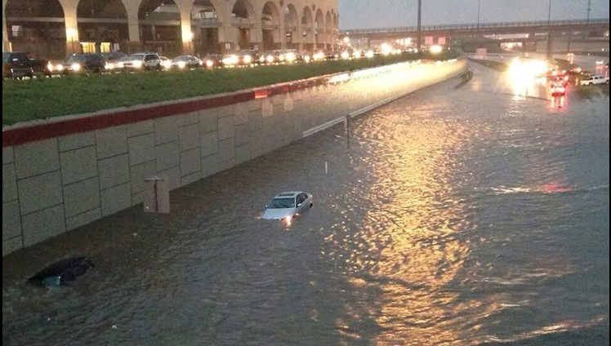
… and flooding

Slide 16
TODAY …
STEPS FOUR and FIVE: Plot the weather station projections using Excel, and plot the gridded data using a program called Panoply.
STEP SEVEN: Calculate one or two more variables that are relevant to your city or region.
STEP EIGHT: Turn your plots into a Powerpoint presentation!

Slide 17
Climate Projections for [insert your city or region]
INSERT A PHOTO OR A PICTURE OF YOUR CITY OR REGION HERE
[YOUR NAME]
[Your Organization or Institution]
Notes:
This sample template was designed by Katharine Hayhoe, Texas Tech University. katharine.hayhoe@ttu.edu

Slide 18
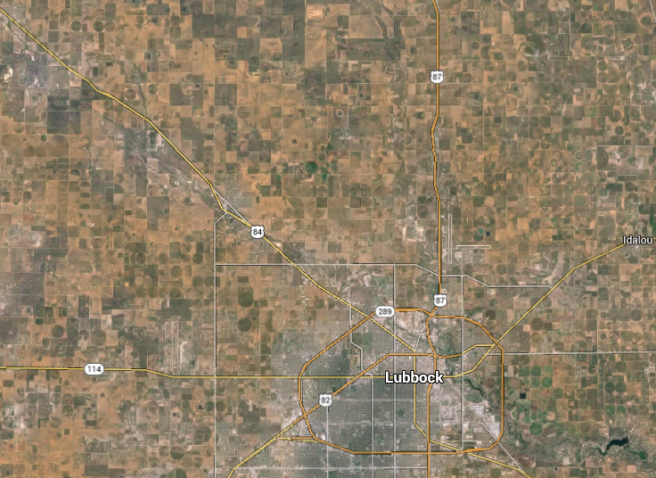

Slide 19
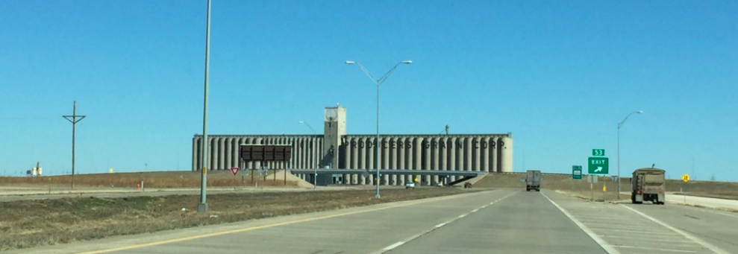
Plan for the curve in the road
to ensure a safe future for all of us.

