Slide 1
WHAT’S NEXT?
Anne Stoner, Katharine Hayhoe, Ranjini Swaminathan

Slide 2
I’d like to take this resource home
Would you like to take this resource – including all the data and the code – with you, so you can continue using it, or share it with others?
If you have a laptop or a USB with at least 120GB storage, we can give you the whole package right now.
If you would like to access it remotely, [explain what they should do here].
Here is an instruction sheet that will tell you what programs you will need to install to make it work on your own computer.
Notes:
I sent Anne the instruction sheet separately. This should be printed and distributed to everyone.

Slide 3
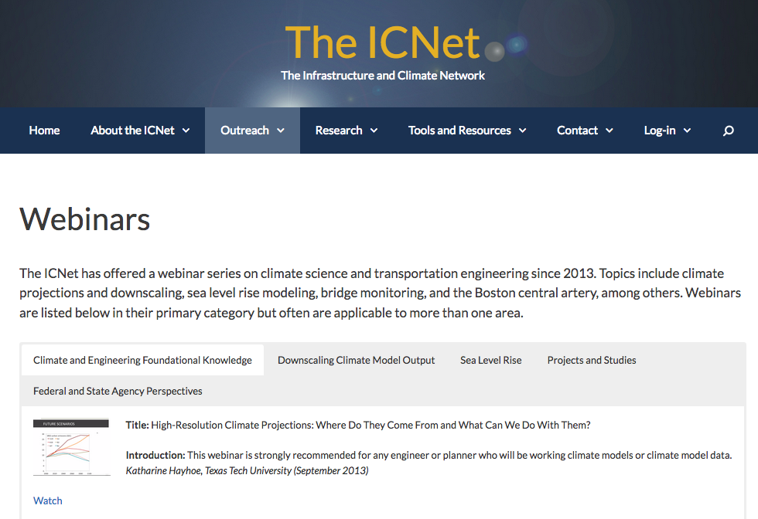
I’d like more information on how to use climate projections
GOOGLE: ICNet Webinars
Notes:
I sent Anne the instruction sheet separately. This should be printed and distributed to everyone.

Slide 4
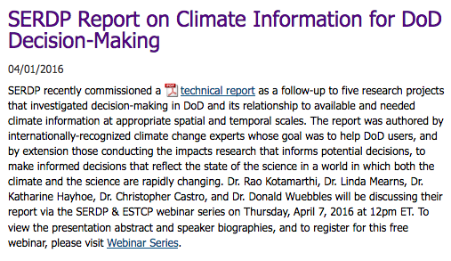
I’d like more information on how to use climate projections
GOOGLE: SERDP Hayhoe Climate
Notes:
I sent Anne the instruction sheet separately. This should be printed and distributed to everyone.

Slide 5
I’d like you to add more weather stations
Do you have more weather station data that you would like to have quality controlled, downscaled, and added to this database?
Please check to make sure the station has at least 10 years of data available. They do not have to be sequential years, but we do need at least 3650 data points.
Send the data to: ranjini.swaminathan@ttu.edu

Slide 6
I’d like to do my own downscaling
The downscaling we have provided uses:
(1) GHCN weather station data, available here: https://www.ncdc.noaa.gov/oa/climate/ghcn-daily/
(2) 0.25 degree gridded data from the Global Meteorological Forcing Dataset, available here: http://hydrology.princeton.edu/data.pgf.php
If the spatial and/or temporal resolution of these observations meet your needs, you do not need to do any further downscaling.

Slide 7
I’d like to do my own downscaling
However, if you have a different dataset you would like to downscale yourself, we are able to make our ARRM code available shortly for those who are already fluent in MATLAB and/or R. (if you are not, you don’t want to do your own downscaling!).
If you are interested, please email me. If we have a few people who are interested, we will hold a virtual webinar later this year to walk you through the program and give you the code.
Send your request to: anne.stoner@ttu.edu

Slide 8
THANK YOU!

