Slide 1
Part 2 – Dashboards
Breakout groups
Dashboards – tracking indicators for climate adaptation planning

Slide 2
Breakout group by sector
Agriculture
Health
Urban
Water (availability, flood,….. Maybe coastal)
Climate data experts – your choice…….

Slide 3
Questions for discussion
Would dashboards be useful to your efforts?
What indicators would you want to track on a dashboard?
What key data for resilience planning are difficult to get?

Slide 4
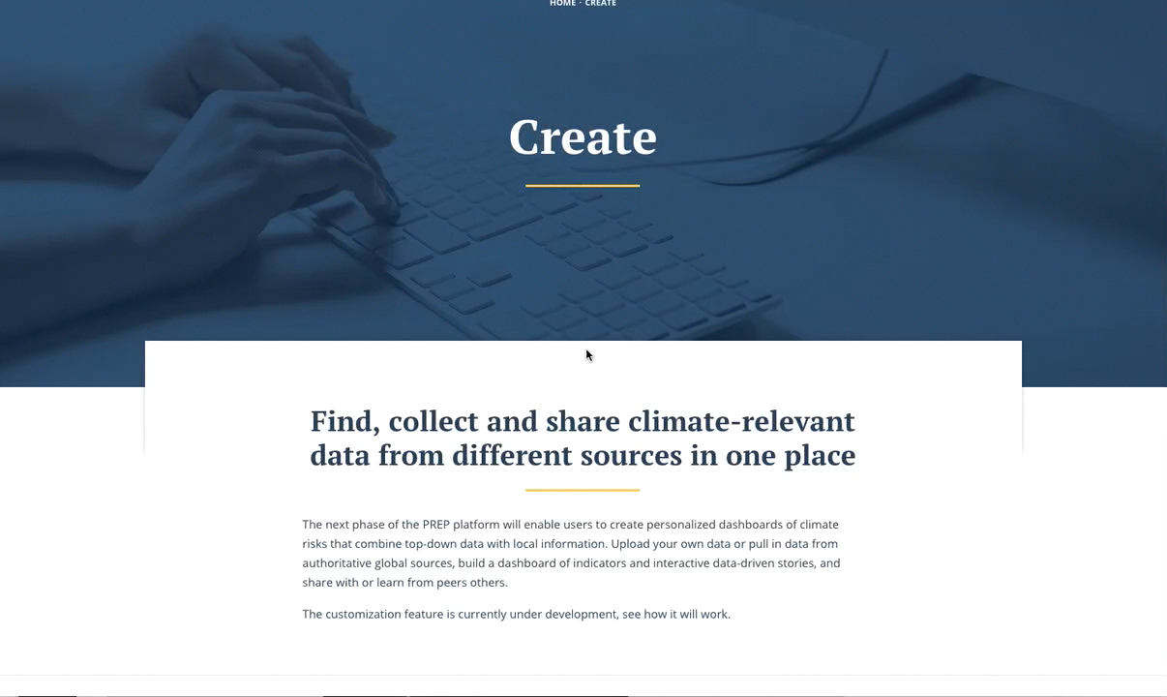

Register your own data
Notes:
As I said, PREP doesn’t just deliver data, it will also allow users to contribute their own.
Users can find, upload, compare, combine, and visualize data relevant to them in one platform.

